Slide 1
International Conference of FEPI – Hosted by HKMS
26th of november 2013 - Zagreb

Slide 2
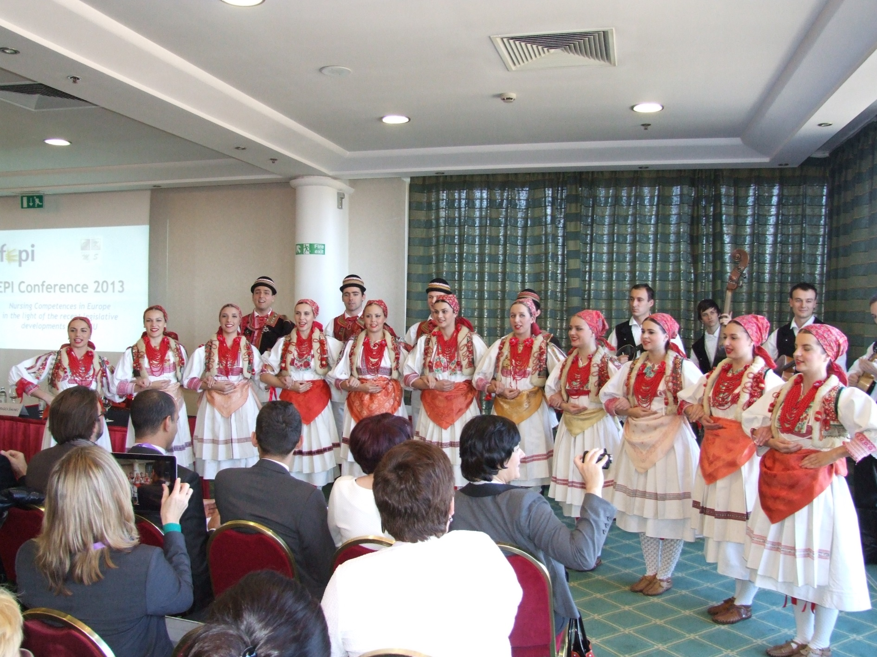
OPENING OF THE CONFERENCE – a Traditional Croatian ChoIr

Slide 3
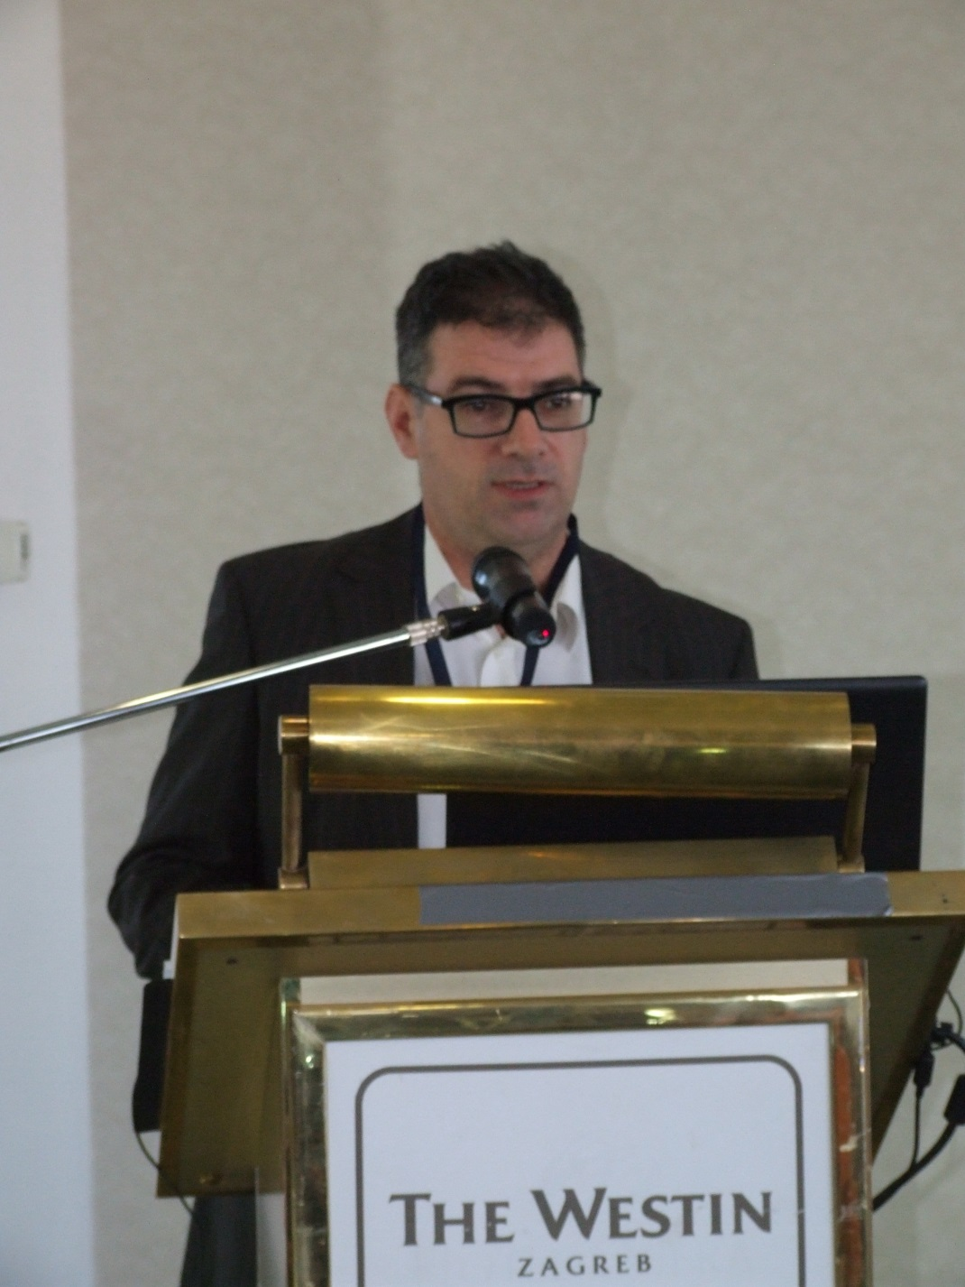
Keynote speaker: Mr. Ian McGonagle

Slide 4
Competences, capabilities and values in nursing practice
Ian McGonagle
University of Lincoln
UDINE –C network

